Slide 1
Nearest Neighbors
CS771: Introduction to Machine Learning
Purushottam Kar

Slide 2
Nearest Neighbour Classifier
A really extreme form of learning with prototypes
Recall that we commented that having multiple (say 2-3) prototypes may help when there is lots of diversity in a class
With NN, every single training point becomes a prototype ☺
The basic mantra here seems to be
If the training email that most resembles a new email was spam, maybe the new email is spam too. Else, if a normal training email most resembles the new email, maybe the new email is normal
“
“

Slide 3
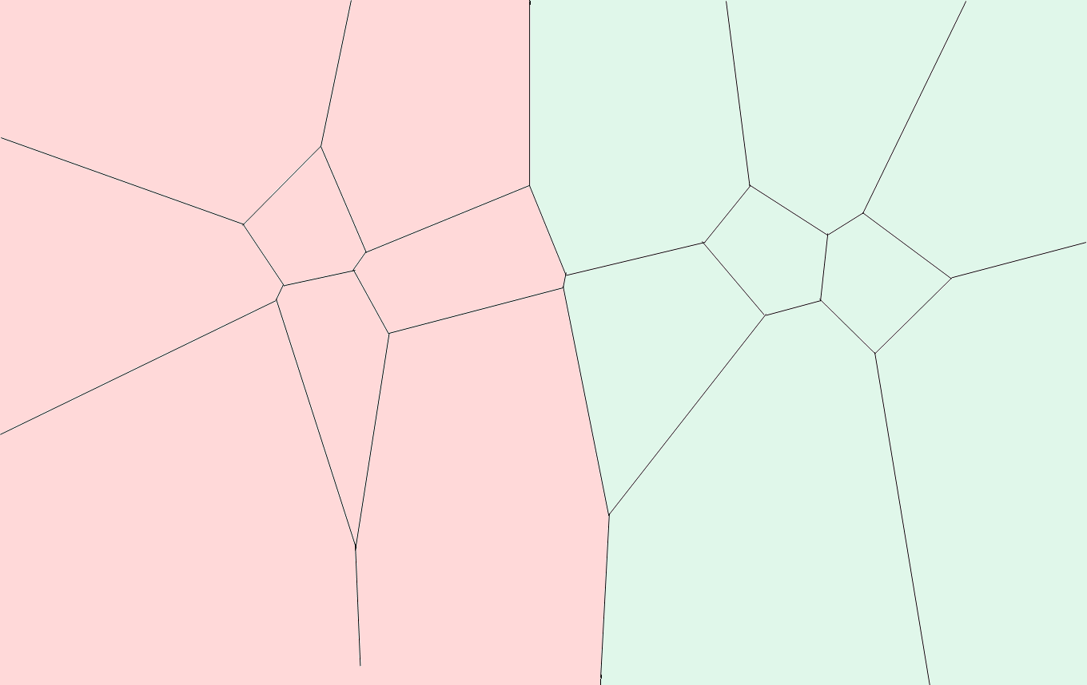

Learning with the 1-NN Classifier
The honeycomb structure we see here demarcates what region of space finds a particular data point as its nearest neighbour. This is called a Voronoi tessellation of the space.
1NN faces much of the same difficulties as learning with prototypes does. In the next class we will study these techniques more

Slide 4
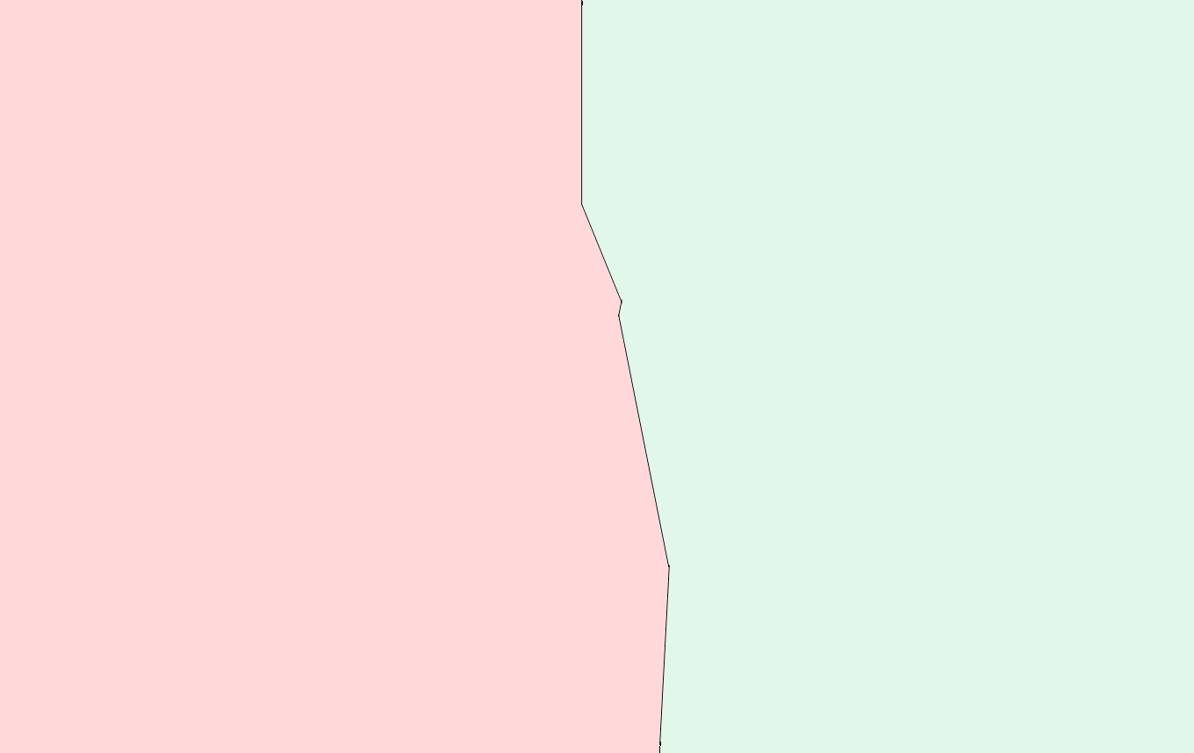


Learning with the 1-NN Classifier
In fact, if we were doing, active learning, we would have asked Mary to tell us the true class of not just points on the boundary but also of those close to it
Depends on the application – if you want to be careful, you can classify boundary points as normal to avoid causing Mary to lose a potentially important email
Decision boundary
What is the decision boundary of LwP classifier?
This is called the decision boundary. On one side of this boundary, I predict spam, on the other I predict non-spam
What if a point lies on the decision boundary? How will you classify that?

Slide 5

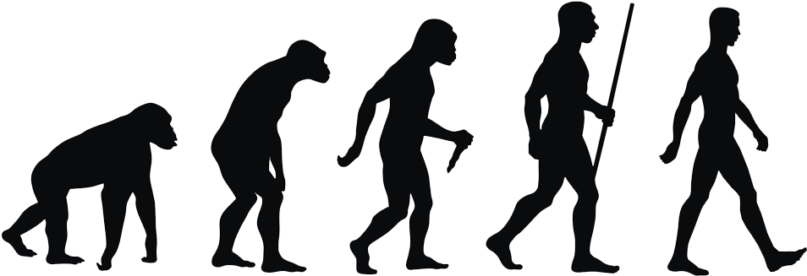

Decision Boundaries
Indeed, since we would have to not only predict for that data point, but also for other data points around it!
Regions of feature space where classifier decision abruptly changes from one class to another class
These are also the regions where classifier may get confused and make a prediction with low confidence
All classifiers have such a decision boundary
Easy to detect whether a test point is at decision boundary for linear classifiers – difficult to do so for most other classifiers, e.g. deep nets
Linear classifiers are those whose decision boundary is a line/plane
Any decision making entity e.g. an ML algorithm or even a
living being, has a decision boundary. Even you and I
have decision boundaries. In the example here,
we would clearly classify as ape on the left and
man on the right. What about the middle?
APE
APE ?
??
MAN
MAN
Correct, we cannot avoid decision boundaries in ML. All we can ensure is that the decision boundaries of our ML models pass through regions from where we do not get too many examples as we want to make confident decisions and at the decision boundary our decisions are made with low confidence
It might still get confused if there are 4 points equally close 2 of them red and 2 green ☺
For example, kNN will never get confused if k = 3 (or some odd number) and 2 classes

Slide 6

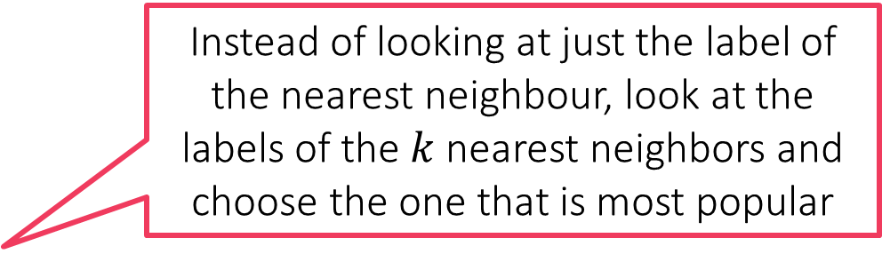
Back to Nearest Neighbors - kNN
Instead of looking at just the label of the nearest neighbour, look at the labels of the $k$ nearest neighbors and choose the one that is most popular

Slide 7

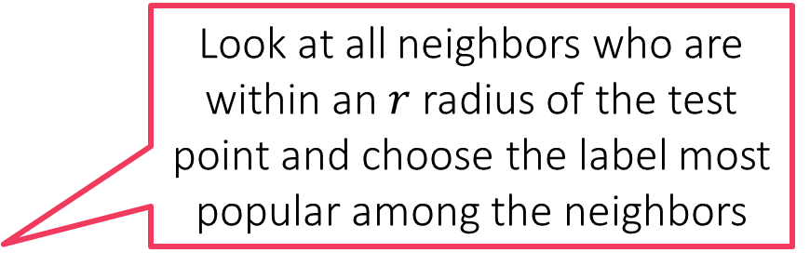
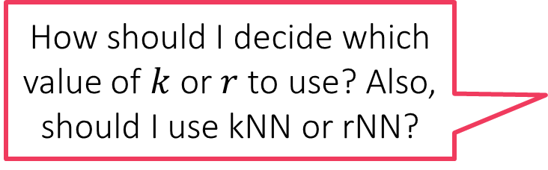
Back to Nearest Neighbors - rNN
Every classifier has a decision boundary even kNN, rNN have some decision boundary (which we hope are better than 1NN’s)
Look at all neighbors who are within an $r$ radius of the test point and choose the label most popular among the neighbors
How should I decide which value of $k$ or $r$ to use? Also, should I use kNN or rNN?

Slide 8

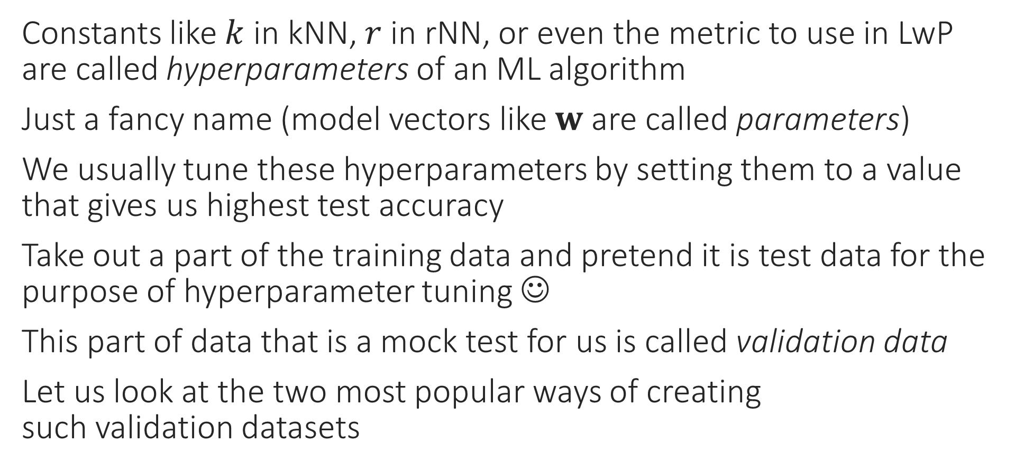
Hyperparameter Tuning in ML
Constants like $k$ in kNN, $r$ in rNN, or even the metric to use in LwP are called hyperparameters of an ML algorithm
Just a fancy name (model vectors like $w$ are called parameters)
We usually tune these hyperparameters by setting them to a value that gives us highest test accuracy
Take out a part of the training data and pretend it is test data for the purpose of hyperparameter tuning ☺
This part of data that is a mock test for us is called validation data
Let us look at the two most popular ways of creating such validation datasets
Looking at test data during training is an execution-worthy crime!

Slide 9

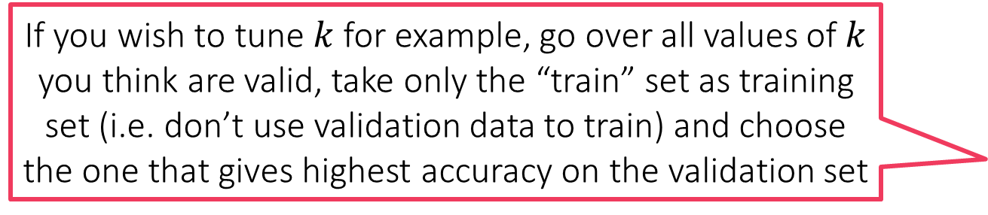
Held-out Validation
If you wish to tune $k$ for example, go over all values of $k$ you think are valid, take only the “train” set as training set (i.e. don’t use validation data to train) and choose the one that gives highest accuracy on the validation set
Non-spam
Spam
Train
Instead, pretend this is test
Train
Non-spam
Validation
Spam
Never touch this during training
If you are concerned that relying on only one split may cause you to choose a wrong value of the hyperparameter (if the split is unlucky). If you feel this is happening, use multi-fold cross validation
Test
Test

Slide 10
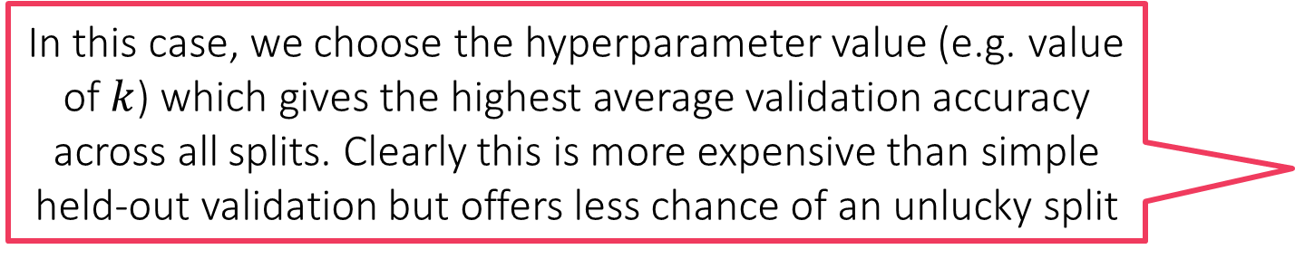
Multi-fold Cross Validation
In this case, we choose the hyperparameter value (e.g. value of $k$) which gives the highest average validation accuracy across all splits. Clearly this is more expensive than simple held-out validation but offers less chance of an unlucky split
Split 1
Split 2
Split 3
Train
Train
Train
Validation
Validation
Validation

Slide 11

Learning with NN – Lessons
Compare this to LwP where model had 2 vectors no matter how many training points – such models are called parametric models
One of the oldest learning algorithms - Fix and Hodges (1951)
Very intuitive, in fact – theoretically, it is the best algorithm possible
In practice it performs well if there is lots and lots of training data
However, not used directly since it takes a lot of time to make a prediction on new test point (finding nearest neighbour expensive)
Instead, clever ways used to speed up calculation of nearest neighbor
Also notice, with NN, all training need to be stored. In LwP, I could throw away training points – lightweight!
Correct! NN requires huge storage too! Note that the model size goes up with the amount of training data ☹
Models whose size depends on the amount of training data are called non-parametric models
Makes sense. If there are 2M training points, each a 10K-dim vector, then naively finding nearest neighbor takes 20B operations i.e. ~20 seconds @ 2GHz
The entire training set is the model – NNs have huge models
Imagine if a bank website took 20 seconds to verify if a credit transaction is valid!
Wait! So what is the “model” for NN?

Slide 12






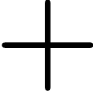

Regression with Weighted
rNN
This neighbour being closer gets more weight
Can I use this trick with kNN? Can I use it while doing classification?
Once you have found the neighbours, you can average their scores to predict a score for the test data point
E.g. when data point is a student and we wish to predict their marks
Yes, and yes. Need to be a bit careful while doing weighted classification since adding labels makes no sense
Or else, you may give the score of closer neighbours more weight and those of far neighbours less weight
In regression, each point needs to be given a real-valued score instead of a label like spam/non-spam

Slide 13

Classification with Weighted rNN
This neighbour being closer gets more weight
This method elegantly works even if there are more than 2 classes!
Green gets 1/3 + 1/3 = 2/3 votes whereas Red gets 1/3 votes – Green wins!!
Green gets 1/5 + 1/5 = 2/5 votes whereas Red gets 3/5 votes – Red wins!!

